Slide 1
GCSE Geography Mock revision lessons
Lo: To revise UK evolving human landscape
Starter: Complete the keywords word search, first person to complete gets a positive point

Slide 2
Completing your definitions
You have 15 minutes to use the textbooks to complete as many of the key words and definitions as you can.
Those of you on the left hand side of the room will start with the words at the bottom of the list.
Those of you on the right hand side of the room will start with the words at the top of the list.
Notes:
Put a 15 minute timer up on the board girl face textbooks

Slide 3
Completing your definitions – team teaching
You have a remaining 5 minutes to join up with a person from the opposite side of the room to collect any definitions you did not get. There will be no textbooks at this point.
Do not copy the definitions your team mate must read them out to you.
Notes:
Put a 5 minute timer up on the board

Slide 4
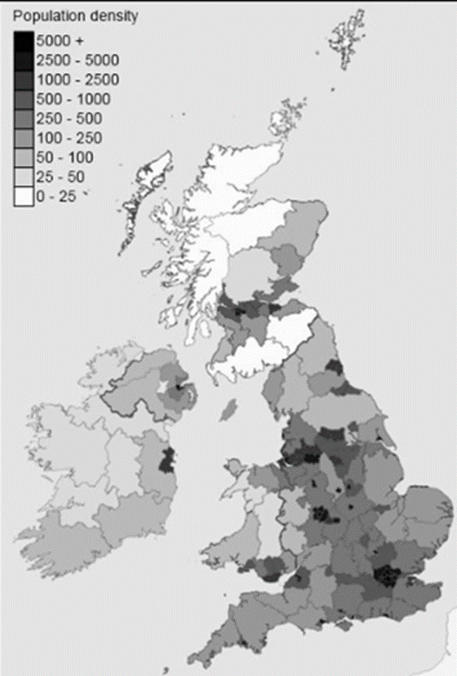
Figure questions
Study figure 1 the population of the UK.
Describe the population distribution of the UK (4)
Population density is highest in cities (1), e.g. London, Glasgow and Birmingham at over 5000 people (1)
It is also high in areas around major cities, or where major cities have developed into conurbations (1) e.g. Liverpool (1).
Upland areas such as Northern Scotland and central Wales are mostly rural. Rural areas are sparsely populated (2).
Other rural areas include the south west and north of England and Northern Ireland where populations are low (2)

Slide 5
Why would urban cores have more economic activity than rural areas? (2)
URBAN
More employment opportunities
More tertiary jobs in retail and finance
Better paid jobs
Bigger work force
RURAL
Fewer job opportunities
More primary industry – farming,
Seasonal jobs – tourism
Poor transport links = long commutes
Lower paid jobs

Slide 6
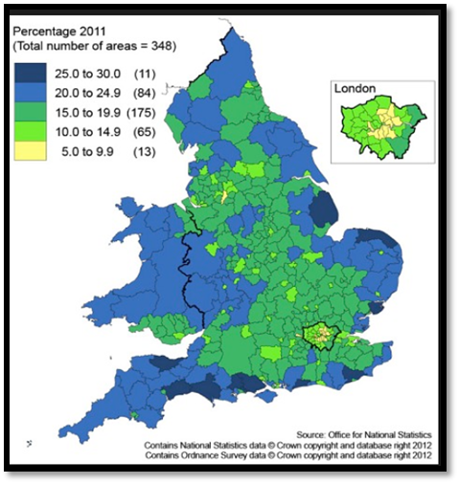
Figure questions
Use the figure, describe the population structure of people over 65 years of age in England and Wales (4)
Remember to include:
Locations
Patterns
The key
Challenge: Explain why urban cores have younger populations than the rural periphery (4)
Notes:
Discuss as class – remember to pick out patterns – bullet point on the board to help them structure the answer

Slide 7
How does the UK and EU government aim to reduce the differences in wealth across the UK?
Read through the information.
Highlight key terms
Explain two ways in which government policies can help rural areas to develop (4)
One way government policies can help rural areas to develop is…….
It helps by ……………….
This creates ………………….
Another way government policies can help rural areas to develop is …………
This means ……………..
Creating ………………
Notes:
Again discuss with students – answers are in the text.. Use the sentence structure to help

Slide 8
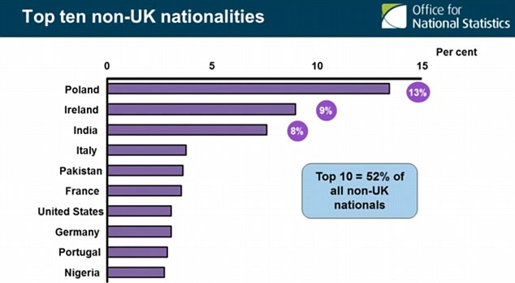
UK immigration policy has increased diversity
What does the graph show you about migration to the UK?
Read through the information in your booklet.
Highlight key terms and statistics
Answer the questions about migration to the UK

Slide 9
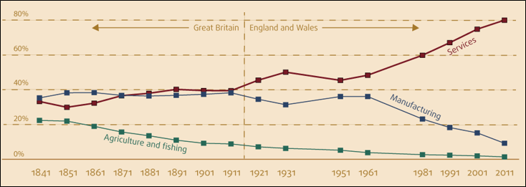
The UK economy – change over time
Number the statements – add the numbers to where the statements correspond with the graph
Notes:
Discuss with the class the changes over time. Pick out patterns and then get them to answer the questions using the help at the bottom of the graph

Slide 10
Explain reasons for the changing UK employment structure (4)
Watch the video clip – why has manufacturing declined in the UK?
https://www.youtube.com/watch?v=CIw4myDfUwQ&list=PLyzEkVd_5NUBwXNfhxyyUFtBDNhC5dY6F
Watch the video clip – what is the knowledge economy? Has this grown or declined?
https://www.youtube.com/watch?v=_-8uhMBl6vI&index=4&list=PLyzEkVd_5NUBwXNfhxyyUFtBDNhC5dY6F
Notes:
Watch the videos and then help students to structure an answer on the board

Slide 11
UK links with the wider world
Watch the video clip – why would companies invest in the UK?
https://www.youtube.com/watch?time_continue=47&v=VNtE_fC-tGk
Explain two reasons why FDI is increasing in the UK (4)
FDI is increasing due to globalisation(1), improving transport and communication links making it easier for companies to operate in the UK (1) such as banks like HSBC.
Furthermore free trade has allowed investment from the EU to increase (1) due to special agreements making it easier to trade between countries within the European Union (1).

Slide 12
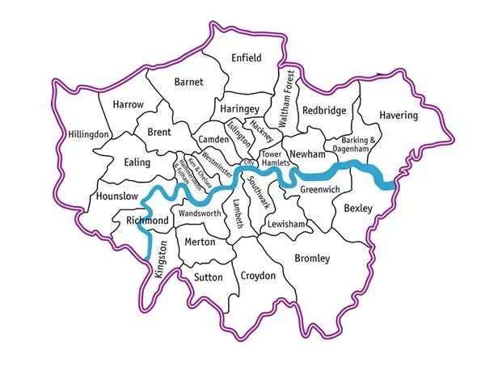
GCSE Geography Mock revision lessons
Lo: To revise Dynamic UK cities – London case study
Starter: name all of the London boroughs, first person to complete gets a positive point

Slide 14
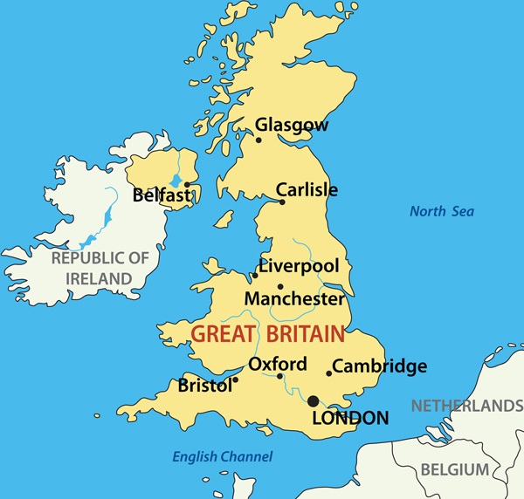
London’s site and situation
Use the information in your pack and the map on the board to answer the following questions:
Describe the site of London (2)
Describe the situation of London (2)

Slide 15
London’s site and situation
Describe the site of London (2)
London is sited on the flat floodplain (1) of the river Thames where it meets the sea (1)
Describe the situation of London (2)
London is close to mainland Europe (1) It has a port (1) making it easy to trade across the English channel (1)

Slide 16
Does London fit the Burgess or Hoyt model?
Read through the information about London. Does it fit either of these models?

Slide 17
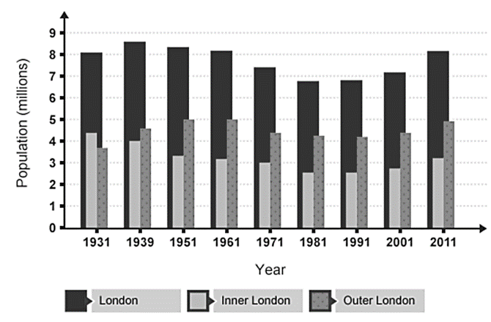
London’s changing population
Watch the video clips. What is London’s population like? How has it changed over time?
Use the figures, answer the questions about London’s population change, are all parts of London seeing population growth?
Notes:
https://www.youtube.com/watch?v=E59yUaQnEPI

Slide 18
London’s changing population
Describe the changes in London’s population over time (4)
London’s population has increased from 1931 to 1961 (1) it then began to decline until 1991 (1) where it has risen steadily since (1) However inner London saw a decline from 1931 to 1991 (1) it has seen an increase from 1991 to 2011 (1)
Notes:
https://www.youtube.com/watch?v=E59yUaQnEPI

Slide 19
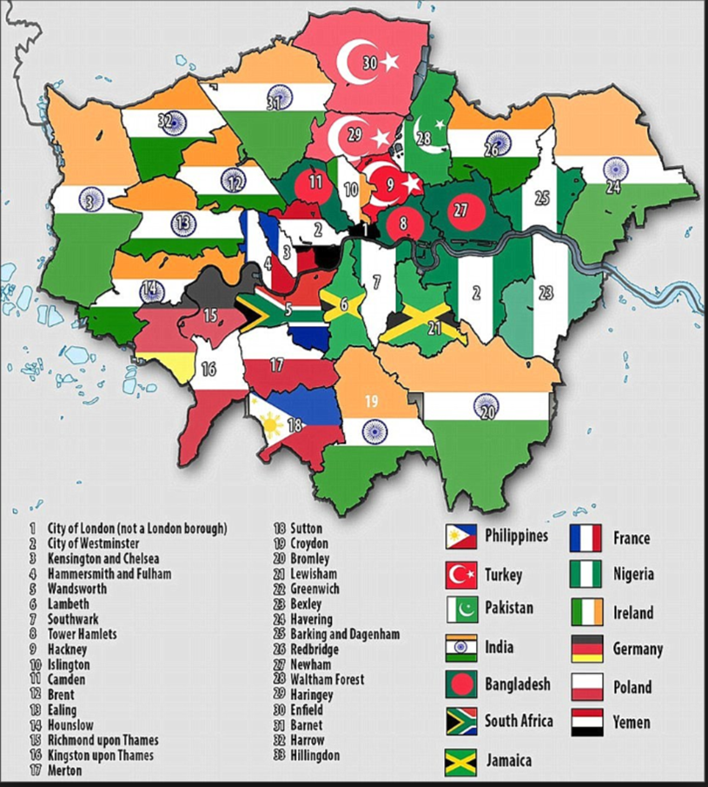
Migration London
Read through the information about migration in London.
Highlight key words and statistics.
Use the map to pick out patterns of migration in London
Answer the questions on migration

Slide 20
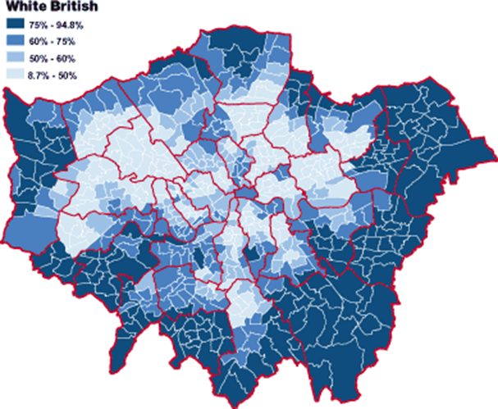
Migration London
Look at the map. Suggest trends or patterns that you can see when looking at White British people living in London.

Slide 21
Assess the impacts of the variations in ethnic group distribution of London boroughs (8)
Remember to include:
Impacts – positives and negatives e.g. Lambeth schools struggle with provision as 50% of students speak English as a second language
Variations – differences e.g. Richmond Upon Thames is 85% white and has little diversity with less pressure on schools compared to Newham which has the highest diversity of the London boroughs.
Distribution – Location – e.g. comparing East London with West London
Point: There is a high ethnic diversity in Lambeth creating pressure on services
Evidence: 50% of student in Lambeth schools speak English as a second language and there are 140 different languages spoken in Lambeth schools.
Explanation: This means that schools must spend extra money on translators and support within classroom draining school budgets. It is also more difficult for these students to achieve 5 GCSEs or more, impacting the type of jobs they will get.
Counterpoint: on the other hand Richmond Upon Thames is 85% white with less strain on schools because 85% of students speak English as their first language.

Slide 22
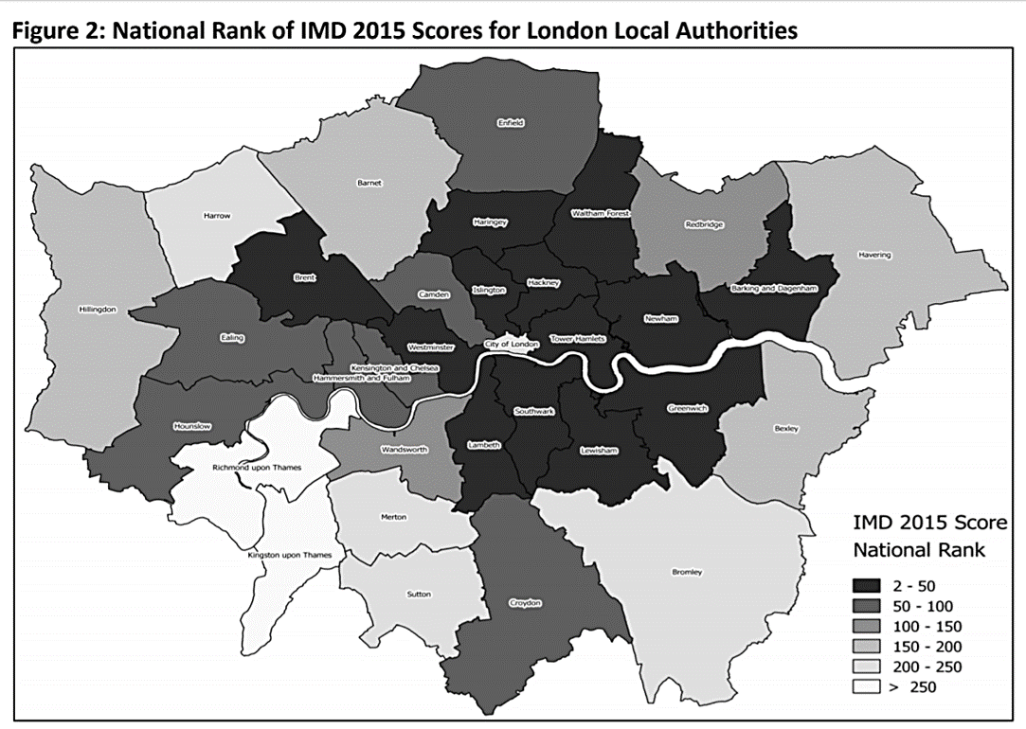
IMD
Index of multiple deprivation
Using the figure: State where the most and least deprived areas of London are? (Try to use borough names, compass directions and N/S of the river)

Slide 23
London’s Decline?
Watch the video clip
Read through the information and highlight key terms and statistics
Explain why many UK cities are experiencing more growth at their edges than in their centres (4)
Deindustrialisation (1) the closing of factories in London docklands led to a loss of jobs in the area (1) people moved out of the city to find work (1) and where housing was cheaper (1)
Improvements in transport into the city (1) led to suburbanisation (1) where people moved out of the city for large cheaper housing (1) and commuted in (1)
Notes:
https://www.youtube.com/watch?v=dlVWhl78Gxg

Slide 24
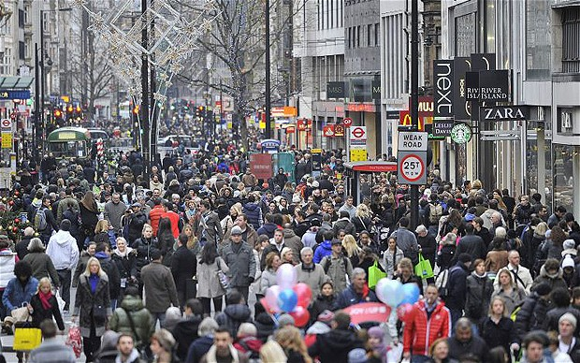
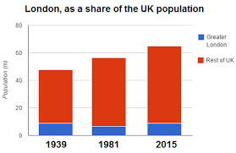
Why invest in London?
Read through the information – how did London Regenerate?
Why have TNC’s invested in London?
What are the future issues for London with a growing population?
Notes:
https://www.standard.co.uk/news/london/londons-population-to-rise-by-one-million-in-next-10-years-a3189106.html

Slide 25
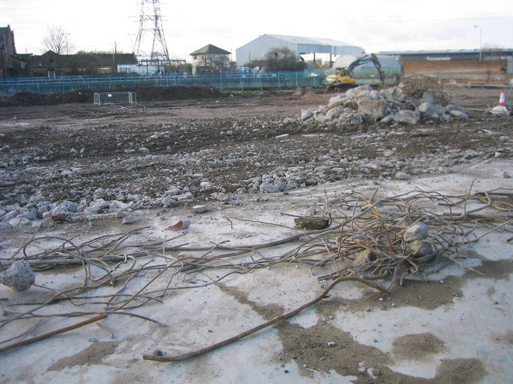
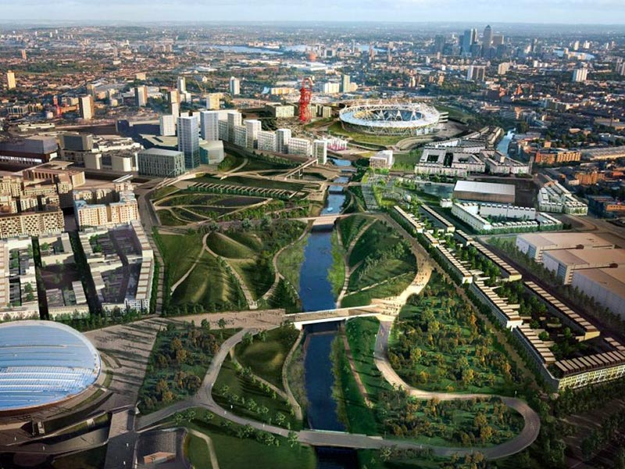
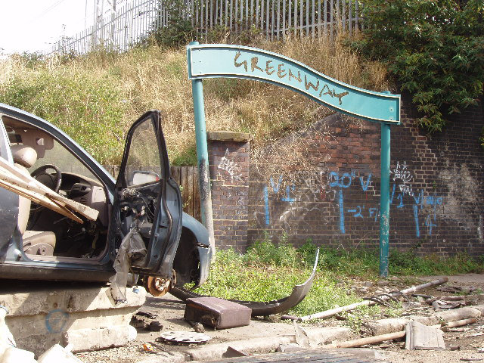
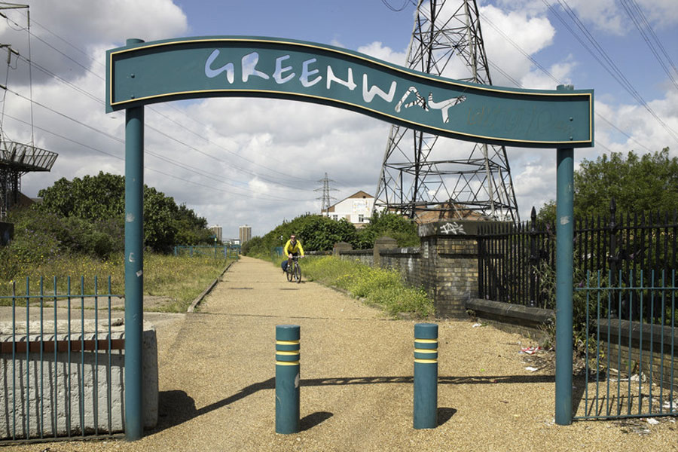
Regeneration – East London - Stratford
Read through the information
Highlight key terms and statistics
Watch the video clip.
Explain how the Olympic park has regenerated East London (4)
Notes:
https://www.londonlive.co.uk/news/2017-08-01/the-olympic-legacy
Show the before and after images of the same locations – discuss

Slide 26
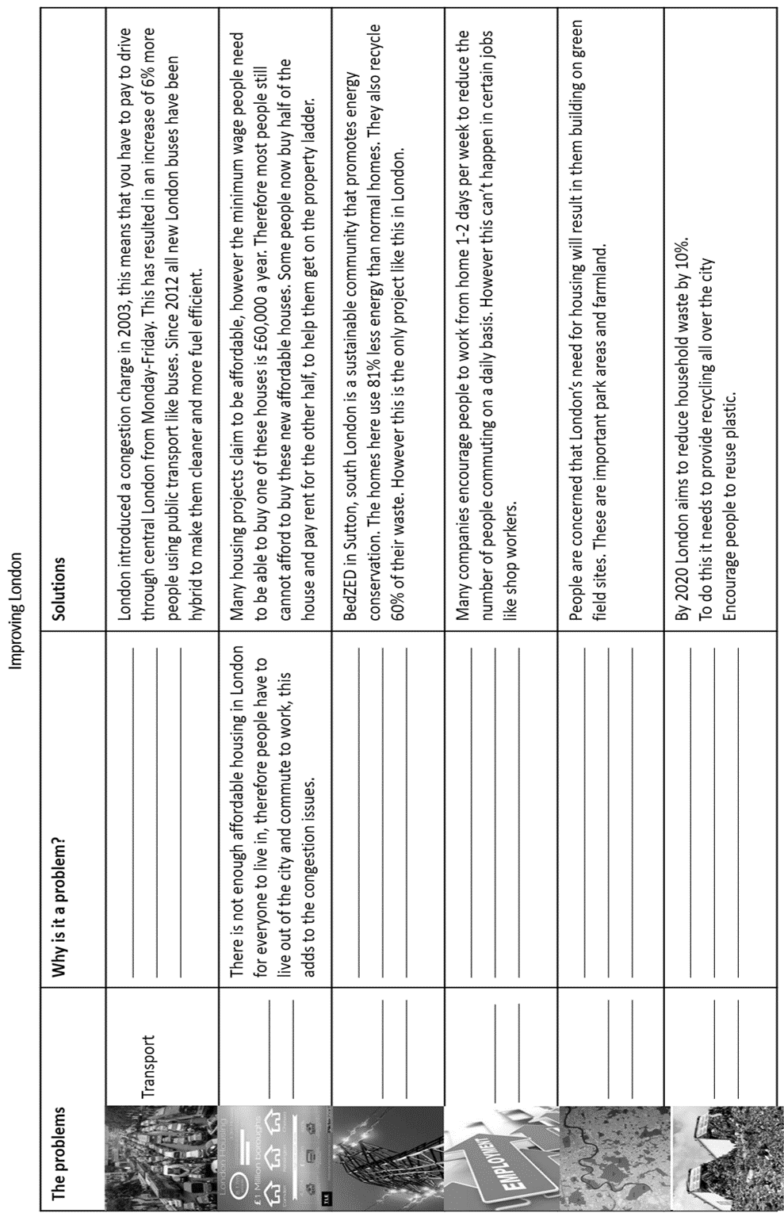
Use the textbook to complete the table
Notes:
Girlface textbook page ___

Slide 27
Improving London Exam question
Read through the 8marker answer. What mark do you think it got. Give the question a WWW/EBI
Evaluate the success of strategies aimed at making urban living more sustainable (8)
1-2 marks – basic ideas of problems with 1 idea of improvement
3-4 marks – basic ideas of problems with 2 ideas of improvements linked to success.
5-6 marks – clear ideas of problems using a case study with linked strategies for improvements, some ideas of how successful a strategy has been.
7-8 marks – clear problems using a case study with linked detailed strategies for improvements and an overall conclusion to how successful each strategy was
Notes:
Go back through the exam question and tick off where the marks come from as you are reading it out

