Slide 1
Abrasion | The scraping away of the river bed by a rivers load | Biodiversity | The variety of FLORA (plants and FAUNA (animals) found in an area | Collision zone | Where two tectonic plates collide forming mountains.
Air Mass | Huge body of air with uniform temperature and humidity | Biofuels | Any kind of fuel from plants or animals | Community Forests | A strategy for improving the environment in England by planting and managing forests
Alluvium | Fine material deposited by rivers when they flood | Bio Gas | Gas made from the break down of organic matter like excrement (poo) which can be burnt. | Congestion charge | a strategy to address climate change and air pollution in London
Artesian water | Water which rises out of the ground under it’s on pressure | Biosphere | The ‘living part of the Earth extending from 3m below the surface to about 30 m above it. | Conservative boundary | Where two tectonic plates slide past each other
Asthenosphere | Part of the Earths Mantle just under the crust | Blue Water | Water stored in dams and used for domestic purposes. | Constructive plate boundary | Where two tectonic plates move apart and Basaltic magma rises up to fill the gap making new crust.
Attrition | Particles of rock collide in the river and breaking apart | Bore Hole | A deep hole drilled for water or Oil | Convection currents | Transfer heat from one part of a liquid or gas two another as a cycle where warm material rises and cooler material sinks
Basalt | Dark coloured volcanic rock which as lava flows easily. | Carbon footprint | Measurement of an individuals total greenhouse gas emissions. | Convergence | Where two things come together and meet such as two tectonic plates or air masses
Base flow | A rivers usual level | Closed System | A system with clear boundaries with no movement in or out. | Desertification | The gradual loss of biodiversity in an area as it becomes a desert.
Milankovitch Cycles | The changing orbit of the Earth around the sun which can cause Glacial and inter glacial periods | Middle Course | The rivers journey is called it’s course the section between the upper course and lower where meanders are common. | Lava | Molten Rock which has erupted out of the Earth

Slide 2
Ecological Footprint | Area of land/sea which provides all of the resources you need to live | Green house gasses | Carbon dioxide and methane which let in solar energy but trap the Earths heat | Interlocking spurs | Mounds on either side of a river in it’s upper course that fit into each other with the river between like a zip.
Ecosystem | A group of living things and the in organic part of their environment. | Helical Flow | The corkscrew motion as water moves down a river | Landslide | A rapid Mass Movement where rock and soil slide down a slope.
El Nino | A change in the location of warm water in the Pacific which leads to natural hazards such as floods and droughts. | Hotspot | A point above a hot column of mantle which creates volcanoes at the Earths surface | Lava Flows | Rivers of lava which flow down hill due to gravity. Most are slow but destructive but some can be quick and dangerous.
Epicentre | The point on the ground directly above the focus of an Earthquake | Hydraulic action | The erosive force of water in a river of stream | Magma | Molten rock below the Earths surface
Eutrophication | When fertiliser from farms washes into lakes or rivers causing algae to grow and kill other species as it rots and uses the oxegen | Hydrosphere | The water which is on or close to the surface of the Earth 97% of which is in seas and Oceans | Magnitude | A measure of how powerful an Earthquake is, how much energy is released
Evaporation | The changing from a liquid to a gas. | Impermeable | Material which will not allow water to pass through. | Mantle | A layer in the Earth below the crust where convection occurs. It is 2900km thick.
Fault | A fracture surface in the Earth which accommodates tectonic movement. Earthquakes occur along these | Infiltration | The movement of water into the soil/ground | Maritime climate | A wet climate with little variation in temperature such as the UK.
Flood plain | The flat area of land around a river created by lateral erosion by meanders and deposition during floods. | Infrastructure | The basic services needed in a country such as roads, hospitals railways and schools | Mass movement | The movement of rocks and soil down slope due to gravity. If it occurs rapidly it is called a land slide.
Glacial Period | A stretch of time which was cold and Earths glaciers expanded | Interception | The capture of rainwater on leaves and trees. | Meander | A bend in a river caused by deposition on the inside of the bend and erosion on the outside

Slide 3
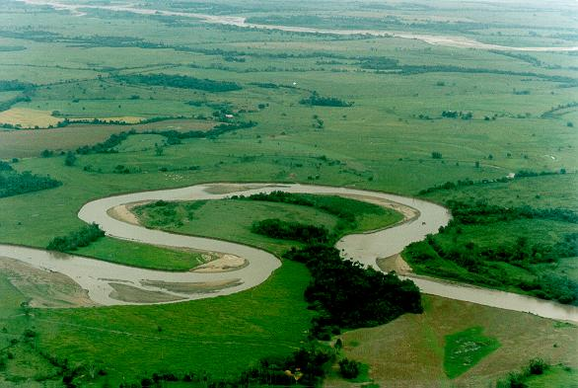
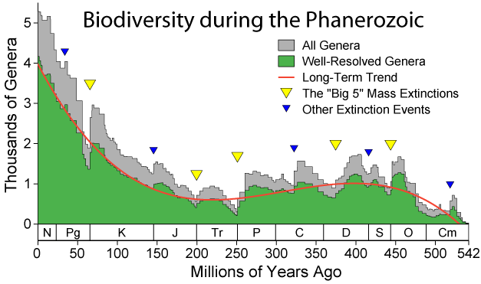
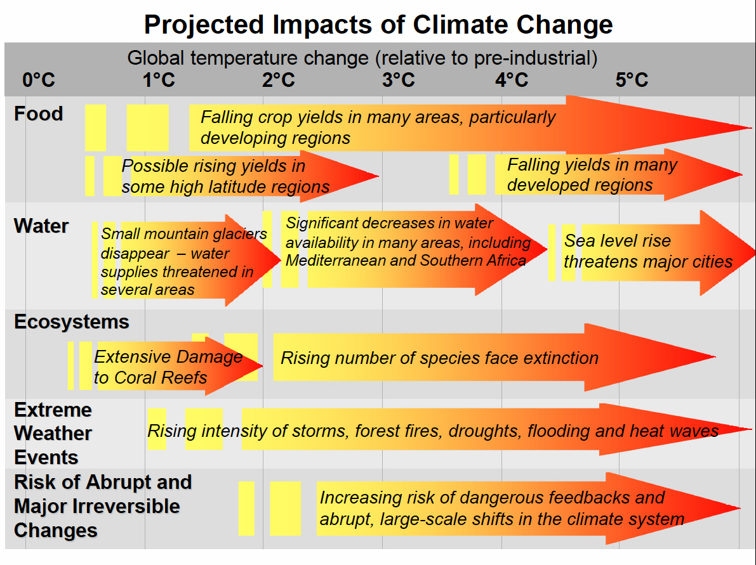
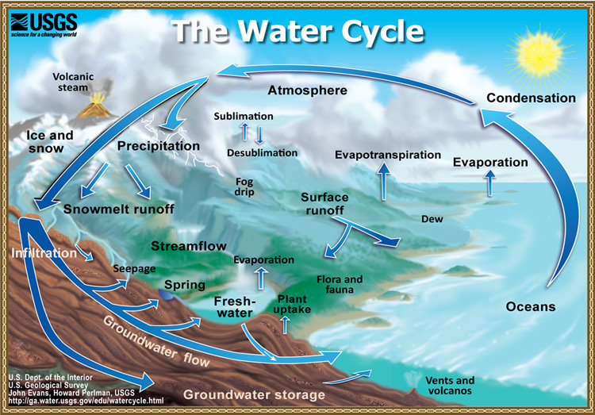
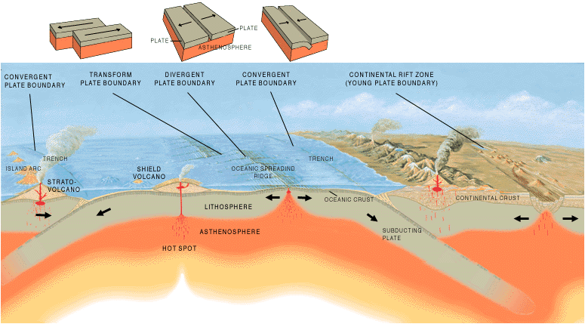
Cut out the key image and match up the definition with the key term around it to form a mind map

